Slide 1
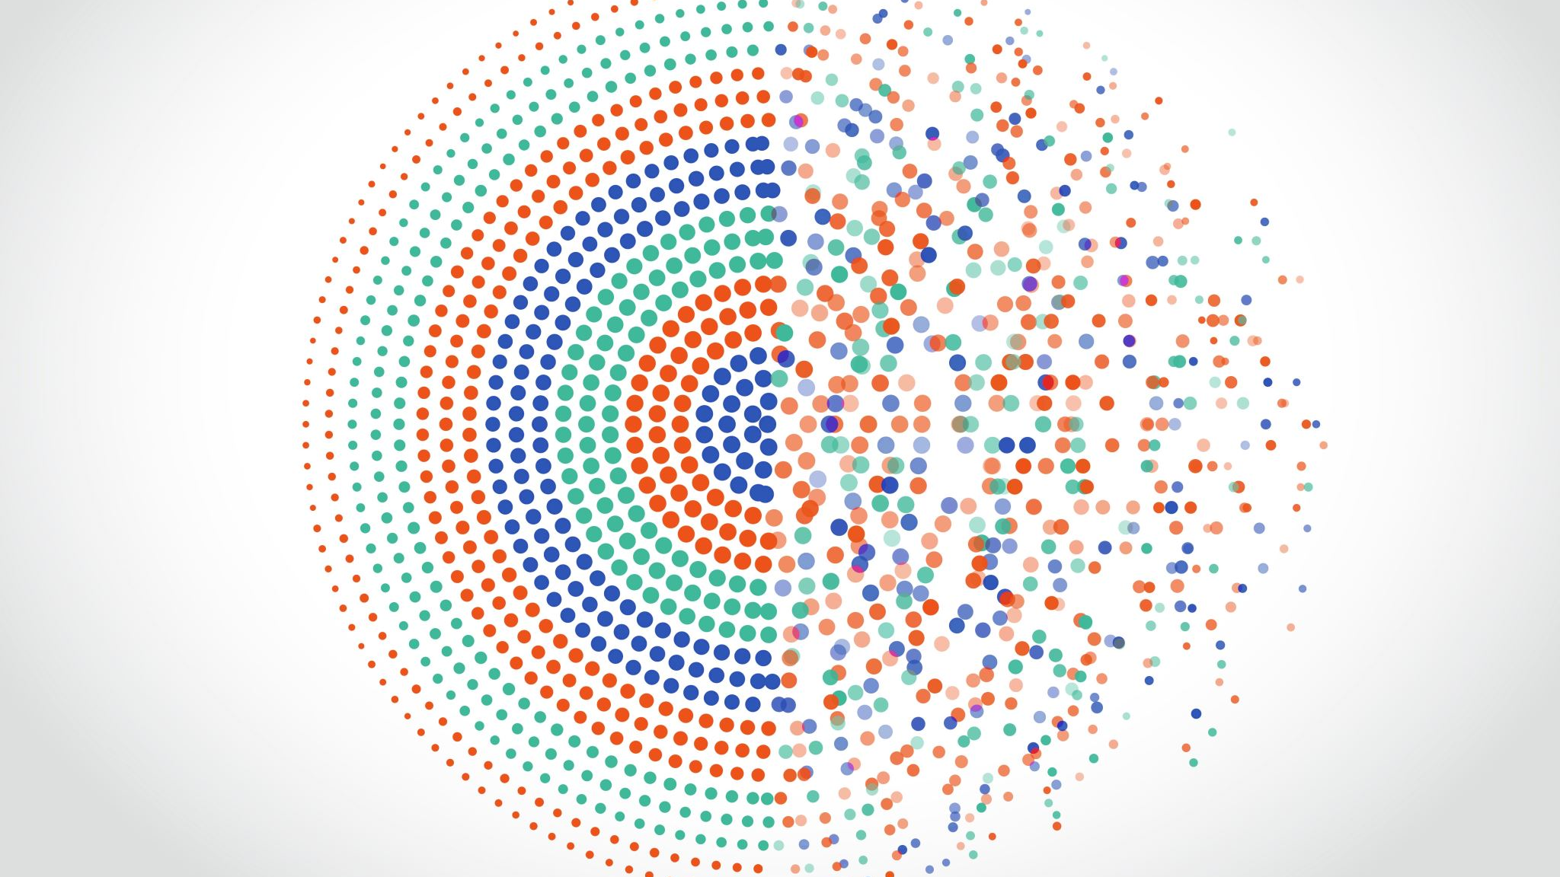
Week 17 : Data visualization using Tableau

Slide 2
Tableau
1 | Introduction to Tableau
2 | Connecting, managing and aggregating data
3 | Visual Analytics in Tableau
4 | Simple predictive analytics using tableau
5 | Building Tableau Dashboards

